Slide 1

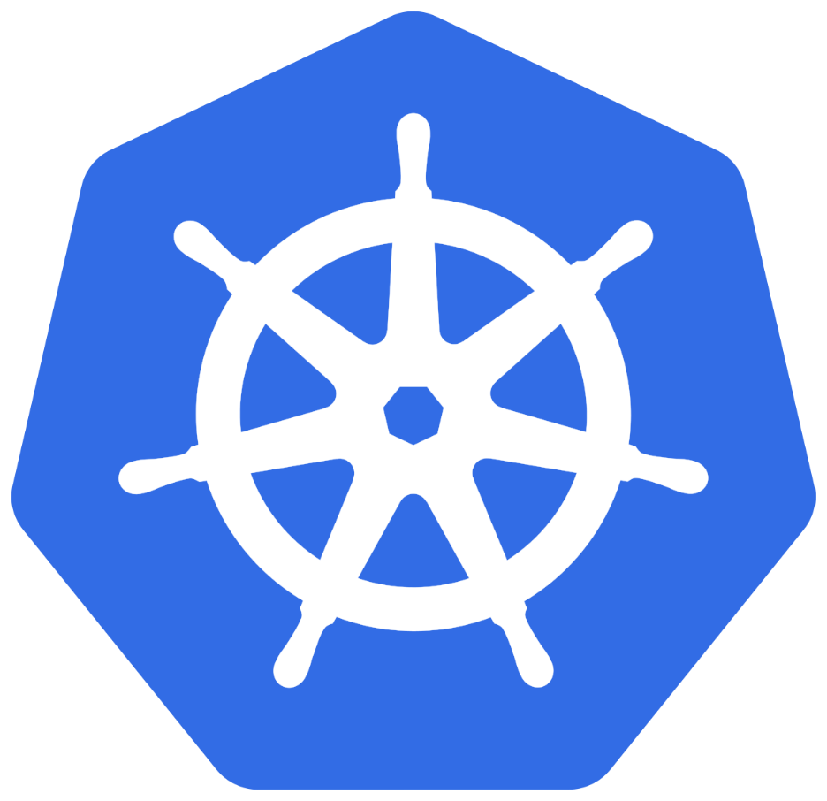
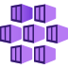
Azure AKS
Create Cluster
Introduction
www.corvit.com

Slide 2
AKS - Introduction
AKS – Azure Kubernetes Service
AKS is highly available, secure and fully managed Kubernetes Service
As on today available in 36 regions and growing.
When compared to other cloud providers, AKS is the one which is available in highest number of regions
Will be able to run any type of workloads
Windows based applications like .Net Apps
Linux supported applications like Java
IOT device deployment and management on demand
Machine Learning Model training with AKS
www.corvit.com

Slide 3

Kubernetes
Architecture
www.corvit.com

Slide 4
Kubernetes - Architecture
Master
Worker Node
Kube Controller Manager
Cloud Controller Manager
Kubelet
Kube-Proxy
Container Runtime (Docker)
kube-apiserver
Worker Node
etcd
kube-scheduler
Kubelet
Kube-Proxy
Container Runtime (Docker)
Container Runtime (Docker)
www.corvit.com

Slide 5
Kubernetes Architecture - Master
Master
kube-apiserver
It acts as front end for the Kubernetes control plane. It exposes the Kubernetes API
Command line tools (like kubectl), Users and even Master components (scheduler, controller manager, etcd) and Worker node components like (Kubelet) everything talk with API Server.
etcd
Consistent and highly-available key value store used as Kubernetes’ backing store for all cluster data.
It stores all the masters and worker node information.
kube-scheduler
Scheduler is responsible for distributing containers across multiple nodes.
It watches for newly created Pods with no assigned node, and selects a node for them to run on.
Kube Controller Manager
Cloud Controller Manager
kube-apiserver
etcd
kube-scheduler
Container Runtime (Docker)
www.corvit.com

Slide 6
Kubernetes Architecture - Master
Master
kube-controller-manager
Controllers are responsible for noticing and responding when nodes, containers or endpoints go down. They make decisions to bring up new containers in such cases.
Node Controller: Responsible for noticing and responding when nodes go down.
Replication Controller: Responsible for maintaining the correct number of pods for every replication controller object in the system.
Endpoints Controller: Populates the Endpoints object (that is, joins Services & Pods)
Service Account & Token Controller: Creates default accounts and API Access for new namespaces.
Kube Controller Manager
Cloud Controller Manager
kube-apiserver
etcd
kube-scheduler
Container Runtime (Docker)
www.corvit.com

Slide 7
Kubernetes Architecture - Master
Master
cloud-controller-manager
A Kubernetes control plane component that embeds cloud-specific control logic.
It only runs controllers that are specific to your cloud provider.
On-Premise Kubernetes clusters will not have this component.
Node controller: For checking the cloud provider to determine if a node has been deleted in the cloud after it stops responding
Route controller: For setting up routes in the underlying cloud infrastructure
Service controller: For creating, updating and deleting cloud provider load balancer
Kube Controller Manager
Cloud Controller Manager
kube-apiserver
etcd
kube-scheduler
Container Runtime (Docker)
www.corvit.com

Slide 8
Kubernetes Architecture – Worker Nodes
Worker Node
Kubelet
Kubelet is the agent that runs on every node in the cluster
This agent is responsible for making sure that containers are running in a Pod on a node.
Kube-Proxy
It is a network proxy that runs on each node in your cluster.
It maintains network rules on nodes
In short, these network rules allow network communication to your Pods from network sessions inside or outside of your cluster.
Kubelet
Kube-Proxy
Container Runtime (Docker)
Container Runtime
Container Runtime is the underlying software where we run all these Kubernetes components.
We are using Docker, but we have other runtime options like rkt, container-d etc.
www.corvit.com

Slide 9
Kubernetes - Architecture
Master
Worker Node
Kube Controller Manager
Cloud Controller Manager
Kubelet
Kube-Proxy
Container Runtime (Docker)
kube-apiserver
Worker Node
etcd
kube-scheduler
Kubelet
Kube-Proxy
Container Runtime (Docker)
Container Runtime (Docker)
www.corvit.com

Slide 10
Kubernetes
Fundamentals
Pod, ReplicaSet, Deployment & Service
www.corvit.com

Slide 11
Kubernetes - Fundamentals
Pod
A POD is a single instance of an Application.
A POD is the smallest object, that you can create in Kubernetes.
ReplicaSet
A ReplicaSet will maintain a stable set of replica Pods running at any given time.
In short, it is often used to guarantee the availability of a specified number of identical Pods
k8s Fundamentals
Deployment
A Deployment runs multiple replicas of your application and automatically replaces any instances that fail or become unresponsive.
Rollout & rollback changes to applications. Deployments are well-suited for stateless applications.
Service
A service is an abstraction for pods, providing a stable, so called virtual IP (VIP) address.
In simple terms, service sits Infront of a POD and acts as a load balancer.
www.corvit.com

Slide 12
Kubernetes - Imperative & Declarative
Kubernetes Fundamentals
Imperative
Declarative
kubectl
YAML & kubectl
Pod
Pod
ReplicaSet
ReplicaSet
Deployment
Deployment
Service
Service
www.corvit.com

Slide 13
Kubernetes
POD
www.corvit.com

Slide 14
Kubernetes - POD
With Kubernetes our core goal will be to deploy our applications in the form of containers on worker nodes in a k8s cluster.
Kubernetes does not deploy containers directly on the worker nodes.
Container is encapsulated in to a Kubernetes Object named POD.
A POD is a single instance of an application.
A POD is the smallest object that we can create in Kubernetes.
N
Nginx Container
Image
N
N
POD
POD
Worker Node
Worker Node
Node
Worker Node
Kubernetes Cluster
www.corvit.com

Slide 15

Kubernetes - POD
PODs generally have one to one relationship with containers.
To scale up we create new POD and to scale down we delete the POD.
N
N
N
N
POD
POD
POD
POD
Worker Node - 1
Worker Node - 2
Kubernetes Cluster
www.corvit.com

Slide 16
Kubernetes – PODs
We cannot have multiple containers of same kind in a single POD.
Example: Two NGINX containers in single POD serving same purpose is not recommended.
N
N
N
N
N
POD
POD
POD
POD
Worker Node - 1
Worker Node - 2
Kubernetes Cluster
www.corvit.com

Slide 17
Kubernetes – Multi-Container Pods
We can have multiple containers in a single POD, provided they are not of same kind.
Helper Containers (Side-car)
Data Pullers: Pull data required by Main Container
Data pushers: Push data by collecting from main container (logs)
Proxies: Writes static data to html files using Helper container and Reads using Main Container.
Communication
The two containers can easily communicate with each other easily as they share same network space.
They can also easily share same storage space.
Multi-Container Pods is a rare use-case and we will try to focus on core fundamentals.
N
H
POD
Worker Node
Kubernetes Cluster
Helper
Containers
Node
www.corvit.com

Slide 18
Kubernetes
PODs
Demo
www.corvit.com

Slide 19


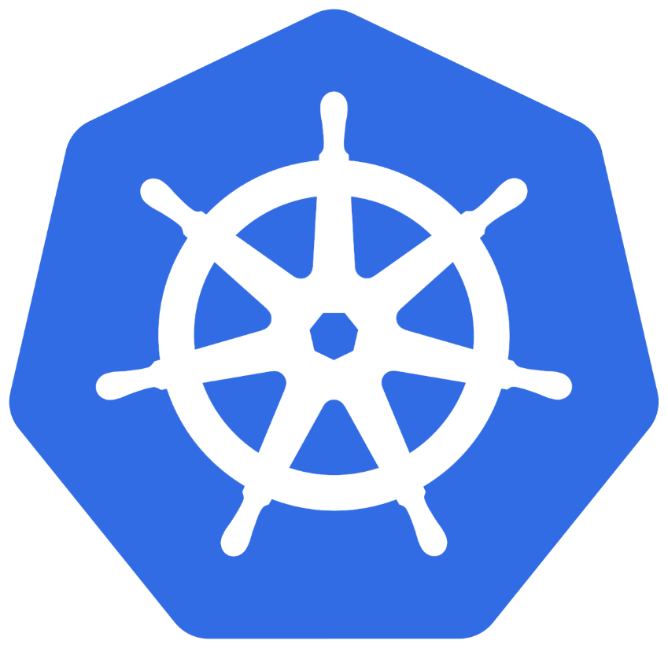
Azure Public
IP Address
Azure Standard
Load Balancer
Kubernetes
Services
Load Balancer
www.corvit.com

Slide 20

Kubernetes – Service - LoadBalancer
User
Azure Standard
Load Balancer
http://<NEW-PUBLIC-IP>
We can expose an application running on a set of PODs using different types of Services available in k8s.
ClusterIP Service(Internal to k8s cluster)
NodePort Service (To internet)
LoadBalancer Service (To internet)
Ingress Service (To internet)
LoadBalancer Service
To access our application outside of Azure AKS k8s cluster, we can use Kubernetes LoadBalancer service which will be eventually mapped to Azure Standard Load Balancer.
When we deploy k8s load balancer service, the following will happen in Azure Standard Load Balancer
A new Public IP gets created and associates that to Frontend IP Configuration
A new Load Balancing rule will be created which associates frontend ip and backend pool
Updated SLB with FrontendIP & LB Rule
Service
Port: 80
ClusterIP Service Port
targetPort: 80
Container Port in a POD
Node
N
POD
Worker Node
Worker Node
Worker Node
Node
Kubernetes Cluster
Azure Cloud
www.corvit.com

Slide 21
Azure Public
IP Address
Azure Standard
Load Balancer
Kubernetes
POD & Load Balancer
Service
Demo
www.corvit.com

Slide 22
Kubernetes
ReplicaSets
www.corvit.com

Slide 23
Kubernetes - ReplicaSets
High Availability or Reliability
Scaling
ReplicaSets
Load Balancing
Labels & Selectors
www.corvit.com

Slide 24
Kubernetes – ReplicaSet
A ReplicaSet’s purpose is to maintain a stable set of replica Pods running at any given time.
If our application crashes (any pod dies), replicaset will recreate the pod immediately to ensure the configured number of pods running at any given time.
Reliability
Or
High Availability
N
N
N
POD
POD
POD
ReplicaSet
Worker Node
Kubernetes Cluster
www.corvit.com

Slide 25

Kubernetes – ReplicaSet
Load Balancing
To avoid overloading of traffic to single pod we can use load balancing.
Kubernetes provides pod load balancing out of the box using Services for the pods which are part of a ReplicaSet
Labels & Selectors are the key items which ties all 3 together (Pod, ReplicaSet & Service), we will know in detail when we are writing YAML manifests for these objects
Service
N
N
N
N
POD
POD
POD
POD
ReplicaSet
Worker Node
Worker Node
Kubernetes Cluster
www.corvit.com

Slide 26
Kubernetes – ReplicaSet
Scaling
When load become too much for the number of existing pods, Kubernetes enables us to easily scale up our application, adding additional pods as needed.
This is going to be seamless and super quick.
Service
N
N
N
N
POD
POD
POD
POD
ReplicaSet
Worker Node
Worker Node
Kubernetes Cluster
www.corvit.com

Slide 27
Kubernetes
ReplicaSets
Demo
www.corvit.com

Slide 28
Kubernetes
Deployments
www.corvit.com

Slide 29
Kubernetes – Deployments
Service
N
N
N
N
POD
POD
POD
POD
ReplicaSet
Deployment
Worker Node - 1
Worker Node - 2
Kubernetes Cluster
www.corvit.com

Slide 30
Kubernetes - Deployment
Create a Deployment to rollout a ReplicaSet
Updating the Deployment
Rolling Back a Deployment
Deployments
Scaling a Deployment
Pausing and Resuming a Deployment
Deployment Status
Clean up Policy
Canary Deployments
www.corvit.com

Slide 31
Kubernetes
Deployments
Demo
www.corvit.com

Slide 32
Kubernetes
Services
www.corvit.com

Slide 33
Kubernetes - Services
ClusterIP
Used for communication between applications inside k8s cluster (Example: Frontend application accessing backend application)
NodePort
Used for accessing applications outside of of k8s cluster using Worker Node Ports (Example: Accessing Frontend application on browser)
Services
LoadBalancer
Primarily for Cloud Providers to integrate with their Load Balancer services (Example: AWS Elastic Load Balancer)
Ingress
Ingress is an advanced load balancer which provides Context path based routing, SSL, SSL Redirect and many more (Example: AWS ALB)
externalName
To access externally hosted apps in k8s cluster (Example: Access AWS RDS Database endpoint by application present inside k8s cluster)
www.corvit.com

Slide 34


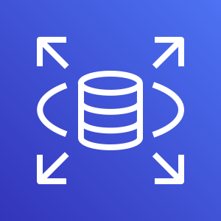
Services
Kubernetes Cluster
Frontend App – NodePort or LoadBalancer or Ingress Service
Users
N
N
N
POD
POD
POD
ReplicaSet
Deployment (app=frontend)
Backend App - ClusterIP Service
AWS Cloud
B
B
B
DB – ExternalName Service
POD
POD
POD
AWS RDS Database
ReplicaSet
Deployment (app=Backend)
www.corvit.com

Slide 35
Kubernetes
Services
Demo
www.corvit.com

Slide 36
Services Demo
Kubernetes Cluster
Frontend App – LoadBalance Service
Users
http://<SVC-Public-IP>/hello
N
POD
ReplicaSet
Deployment (app=frontend)
Backend App - ClusterIP Service
B
POD
ReplicaSet
Deployment (app=Backend)
www.corvit.com

Slide 37
Kubernetes
YAML Basics
www.corvit.com

Slide 38
YAML Basics
YAML is not a Markup Language
YAML is used to store information about different things
We can use YAML to define key, Value pairs like variables, lists and objects
YAML is very similar to JSON (Javascript Object Notation)
YAML primarily focuses on readability and user friendliness
YAML is designed to be clean and easy to read
We can define YAML files with two different extensions
abc.yml
abc.yaml
www.corvit.com

Slide 39
YAML Basics
YAML Comments
YAML Key Value Pairs
YAML Dictionary or Map
YAML Array / Lists
YAML Spaces
YAML Document Separator
www.corvit.com

Slide 40
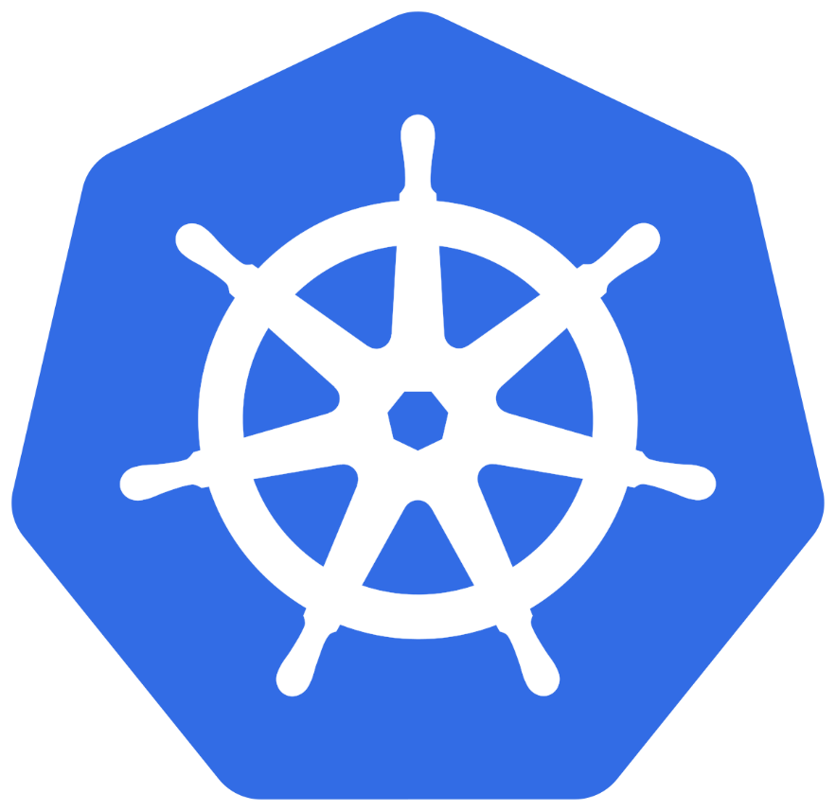


Azure AKS Storage
with
Azure Disks & Files
www.corvit.com

Slide 41
AKS Storage Concepts
Storage Concepts
Volumes (K8S)
Persistent Volumes
Storage Classes
Persistent Volume Claims
emptyDir
Azure Disks
default
Dynamically provision the storage
secret
Azure Files
managed-premium
configMap
azurefile
azurefile-premium
www.corvit.com

Slide 42
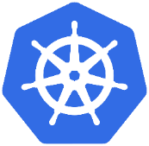

Why do we need Persistent Storage in Kubernetes?
Volumes that are defined and created as part of the pod lifecycle only exist until the pod is deleted.
Pods often expect their storage to remain if a pod is rescheduled on a different host during a maintenance event, especially in StatefulSets.
A persistent volume (PV) is a storage resource created and managed by the Kubernetes API that can exist beyond the lifetime of an individual pod.
For AKS, Azure Disks or Azure Files are used to provide the PersistentVolume.
Azure AKS Cluster
Persistent Volume
(Static / Dynamic)
Single Node / Pod Access
Azure Managed Disks
Azure Files
Multiple Concurrent Node / Pod Access
Azure Storage Account
www.corvit.com

Slide 43
Persistent Volume Claims – How it works?
PVC will request storage based on specifics from Storage class (Disk or File)
Kube API Server will dynamically provision the Persistent Volume PV requested
Once the PV is available it will get mounted to Pod for usage.
create a pod
Azure AKS Cluster
Storage Class
Azure Managed Disks
Premium / Standard
Storage
POD
Persistent Volume Claim
Persistent Volume
Mount the Volume to Pod
Worker Node
Azure Files
(Standard Storage)
Storage Account
www.corvit.com

Slide 44
Azure AKS Storage
with
Azure Disks
www.corvit.com

Slide 45
Azure Disks - Introduction
Azure Disk Storage offers high-performance, highly durable block storage for our mission- and business-critical workloads
We can mount these volumes as devices on our Virtual Machines & Container instances.
Cost-effective storage
Built-in bursting capabilities to handle unexpected traffic and process batch jobs cost-effectively
Unmatched resiliency
0 percent annual failure rate for consistent enterprise-grade durability
Seamless scalability
Dynamic scaling of disk performance on Ultra Disk Storage without disruption
Built-in security
Automatic encryption to help protect your data using Microsoft-managed keys or your own
www.corvit.com

Slide 46
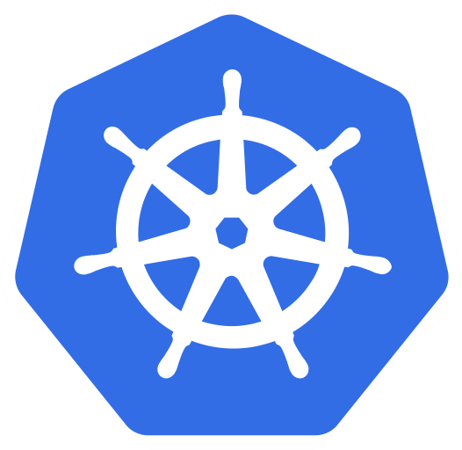
AKS Storage Azure Disks
Azure AKS Cluster
Azure Disks
MySQL – ClusterIP Service
Config Map
Storage Class
Environment Variables
Persistent Volume Claim
Volumes
MySql
Persistent Volumes
Volume Mounts
POD
ReplicaSet
Deployment
Deployment (mysql)
ClusterIP Service
www.corvit.com

Slide 47
Azure AKS Cluster
http://<External-IP-from-get-service-output>
UserMgmt – LoadBalancer Service
Users
Load Balancer Service
Deployment
Web
App
Environment Variables
POD
ReplicaSet
Init Containers
Azure Disks
Deployment (UserMgmt)
MySQL – ClusterIP Service
Config Map
Storage Class
Environment Variables
Persistent Volume Claim
Volumes
MySql
AKS Storage Azure Disks
Persistent Volumes
Volume Mounts
POD
ReplicaSet
Deployment
Deployment (mysql)
ClusterIP Service
www.corvit.com

Slide 48
Azure AKS Storage
with
Azure Files
www.corvit.com

Slide 49
Azure Files
These are simple, secure and fully managed cloud file shares
We can secure data at rest and in-transit using SMB 3.0 and HTTPS
We can create high-performance file shares using the Premium Files storage tier
We can replace or supplement on-premises file servers
Scripting and tooling: PowerShell cmdlets and Azure CLI can be used to create, mount, and manage Azure file shares as part of the administration of Azure applications.
We can create and manage Azure file shares using Azure portal and Azure Storage Explorer.
For Application workloads we can use for use cases like Static Content storage, shared configuration access to multiple JVMs etc.
www.corvit.com

Slide 50
http://<External-IP-from-get-service-output>/app1/file1.html
Azure AKS Cluster
LoadBalancer Service
Users
Load Balancer Service
AKS Storage Azure Files
Deployment
NGINX
NGINX
NGINX
POD
POD
POD
Volumes
ReplicaSet
Deployment
Volume Mounts
Storage Class
Key Advantage with Azure File Shares:
Multiple pods can access the single file share
Azure Storage Account
Persistent Volume Claim
file1.html
file2.html
Persistent Volumes
</>
HTML
</>
HTML
Azure File Shares
www.corvit.com

Slide 51
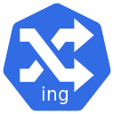
Azure AKS
Ingress
www.corvit.com

Slide 52
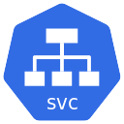



Why do we need Ingress?
Azure
AKS
type: LoadBalancer
Public IP-1
Service: App1
App1
Service: App2
App2
Public IP-2
AKS
Load Balancer
No SSL Termination
Public IP-3
Service: App3
App3
We have 3 public Ips for 3 apps – Not good
In simple terms, native Kubernetes services cannot do all the reverse proxy magic and we need something else in k8s do and there comes ingress
www.corvit.com

Slide 53
What is Ingress?
Ingress is a Kubernetes resource that lets us configure an HTTP load balancer for applications running on Kubernetes, with advanced capabilities at HTTP layer.
Context Path based Routing
Ingress
Features
Host based Routing
TLS / SSL Termination
www.corvit.com

Slide 54
Ingress - Terminology
Ingress Controller
Ingress Resource or Service
Ingress controller is an application that runs in a cluster and configures an HTTP load balancer according to Ingress resources.
Equivalent to Kubernetes Services but with lot of additional features
The load balancer can be a software load balancer running in the cluster or a hardware or cloud load balancer running externally.
We can define routing rules based on URI or Hostname in Ingress Resource Manifest
In the case of NGINX, the Ingress controller is deployed in a pod along with the load balancer.
We can even define SSL / TLS related information in Ingress Resource Manifest
www.corvit.com

Slide 55
Azure AKS & Nginx Ingress – Context Path Based Routing
Azure
Azure AKS Cluster
Nginx App1
/app1/
/app2/
/
Ingress Service
Nginx App2
Users
Public IP
for Ingress
Controller
Ingress Controller
AKS
Load Balancer
Usermgmt WebApp
www.corvit.com

Slide 56

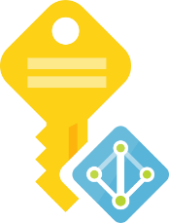

Azure AKS Nginx Ingress Hostname based Routing External DNS
Azure
Azure AKS Cluster
Virtual Machine
Scale Sets
DNS
Zones
Managed
Service
Identity
Nginx App1
External DNS
eapp1.kubeoncloud.com
eapp2.kubeoncloud.com
eapp3.kubeoncloud.com
Nginx App2
Ingress Service
Users
Public IP
for Ingress
Controller
Ingress Controller
AKS
Load Balancer
Usermgmt WebApp
www.corvit.com

Slide 57

Azure AKS Nginx Ingress External DNS SSL with Lets Encrypt
Azure
Azure AKS Cluster
Virtual Machine
Scale Sets
External DNS
DNS
Zones
Managed
Service
Identity
cert-manager
sapp1.kubeoncloud.com
sapp2.kubeoncloud.com
Nginx App1
Ingress Service
Users
Public IP
for Ingress
Controller
Ingress Controller
AKS
Load Balancer
Nginx App2

Slide 58
Nginx Ingress Controller - References
List of Ingress Controllers
https://kubernetes.io/docs/concepts/services-networking/ingress-controllers/
Azure AGIC (Application Gateway Ingress Controller)
https://github.com/Azure/application-gateway-kubernetes-ingress
https://azure.microsoft.com/en-in/pricing/details/application-gateway/
www.corvit.com

Slide 59
Azure AKS
Nginx Ingress Service
Install & Implement
www.corvit.com

Slide 60
Azure AKS & Nginx Ingress – Basic Architecture
Azure Cloud
Azure AKS Cluster
Nginx App1
/
Ingress Service
Users
Public IP
for Ingress
Controller
Ingress Controller
AKS
Load Balancer
www.corvit.com

Slide 61
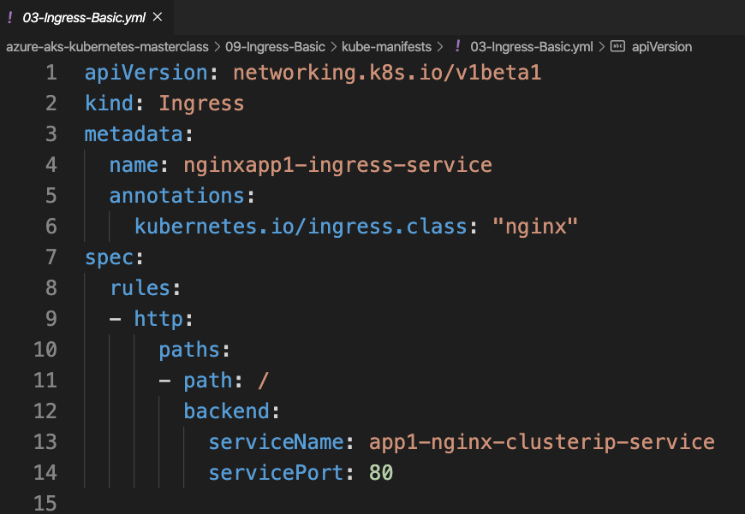
Basic Ingress Manifest
Deprecated
www.corvit.com

Slide 62
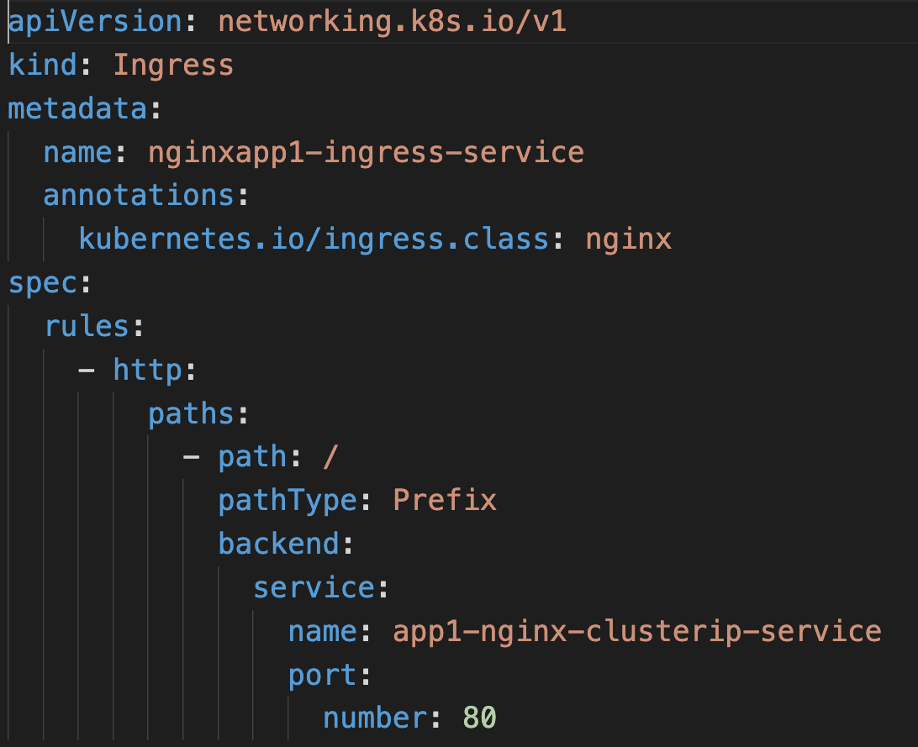
Basic Ingress Manifest
NEW
www.corvit.com

Slide 63
Azure AKS
Nginx Ingress Service
Context Path based Routing
www.corvit.com

Slide 64
Azure AKS & Nginx Ingress – Context Path Based Routing
Azure
Azure AKS Cluster
Nginx App1
/app1/
/app2/
/
Ingress Service
Nginx App2
Users
Public IP
for Ingress
Controller
Ingress Controller
AKS
Load Balancer
Usermgmt WebApp
www.corvit.com

Slide 65
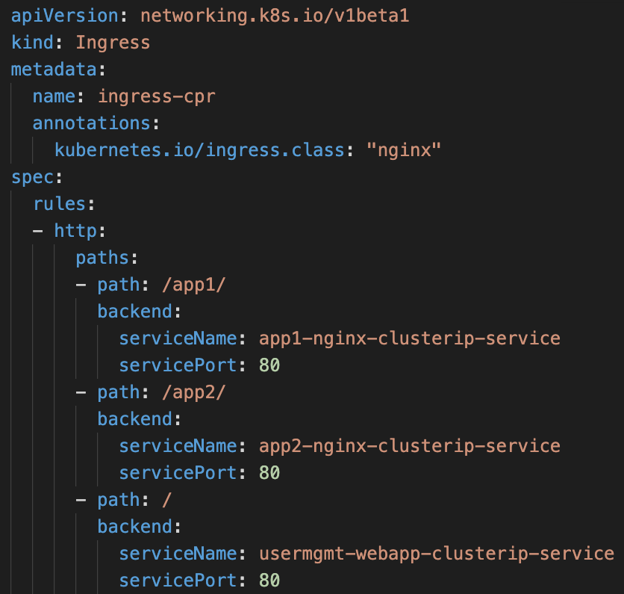
Ingress CPR Manifest
www.corvit.com

Slide 66
Azure AKS
&
Azure DNS Zones
www.corvit.com

Slide 67
Domain Registrar
A domain registrar is a company who can provide Internet domain names.
Example: GoDaddy, Wix, Namcheap, AWS Route53
They verify if the Internet domain you want to use is available and allow you to purchase it.
Once the domain name is registered, you are the legal owner for the domain name.
If you already have an Internet domain, you will use the current domain registrar to delegate to Azure DNS.
www.corvit.com

Slide 68
DNS Zone
A domain is a unique name in the Domain Name System, for example stacksimplify.com.
A DNS zone is used to host the DNS records for a particular domain.
For example, the domain stacksimplify.com may contain several DNS records such as
mail.stacksimplify.com (for a mail server)
www.stacksimplify.com (for a website).
courses.stacksimplify.com (Sub domains to host other applications)
www.corvit.com

Slide 69
Azure DNS Zones
Azure DNS is not the domain registrar.
Azure DNS allows you to host a DNS zone and manage the DNS records for a domain in Azure.
For DNS queries for a domain to reach Azure DNS, the domain must be delegated to Azure DNS from the parent domain
www.corvit.com

Slide 70
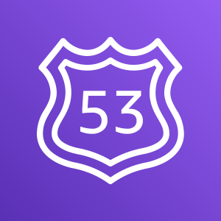
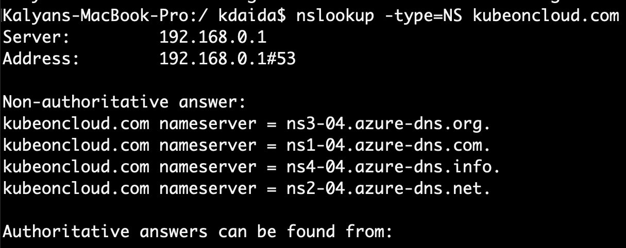
Delegate Domain to Azure DNS
AWS Cloud
Azure Cloud
DNZ Zones
Domain Registrar
kubeoncloud.com
kubeoncloud.com
AWS Route53
Azure DNS Zones
www.corvit.com

Slide 71
DNS
Zones
Managed
Service
Identity
Azure AKS
Nginx Ingress Service
External DNS
www.corvit.com

Slide 72
Kubernetes External DNS
ExternalDNS synchronizes exposed Kubernetes Services and Ingresses with DNS providers.
In simple terms, ExternalDNS allows you to control DNS records dynamically via Kubernetes resources in a DNS provider-agnostic way.
Reference: https://github.com/kubernetes-sigs/external-dns
www.corvit.com

Slide 73
Azure AKS Nginx Ingress External DNS
Azure
Azure AKS Cluster
Virtual Machine
Scale Sets
DNS
Zones
Managed
Service
Identity
Nginx App1
External DNS
eapp1.kubeoncloud.com
Ingress Service
eapp1.kubeoncloud.com
Users
Public IP
for Ingress
Controller
Ingress Controller
AKS
Load Balancer
www.corvit.com

Slide 74
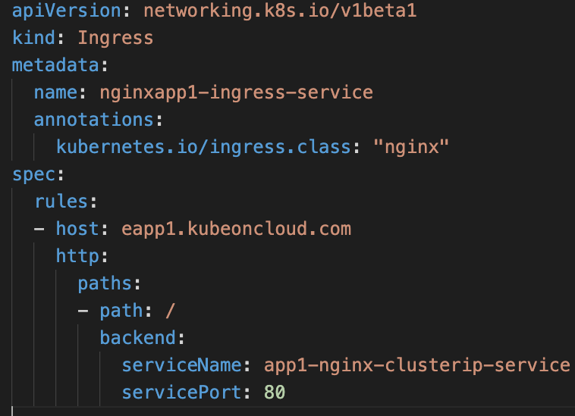
Ingress with External DNS
This will help us to add DNS Record Set in Azure DNS Zones using k8s External DNS
www.corvit.com

Slide 75
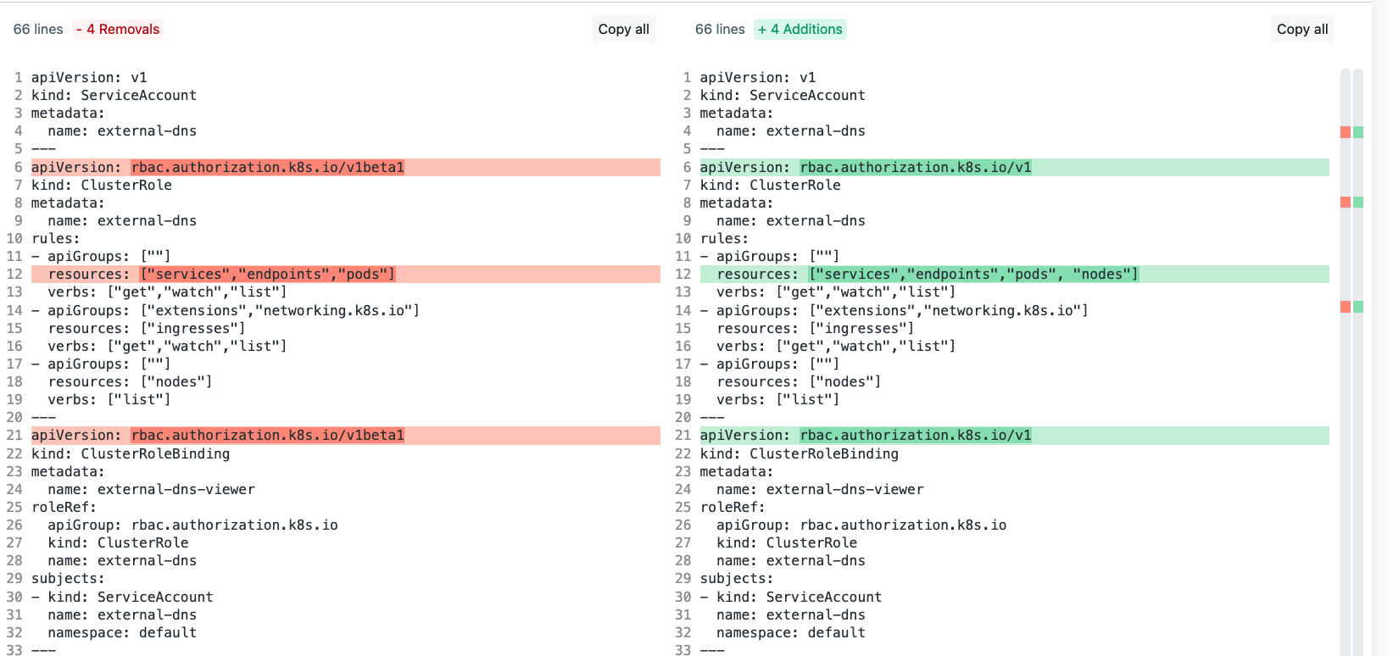
External DNS Updates
www.corvit.com

Slide 76
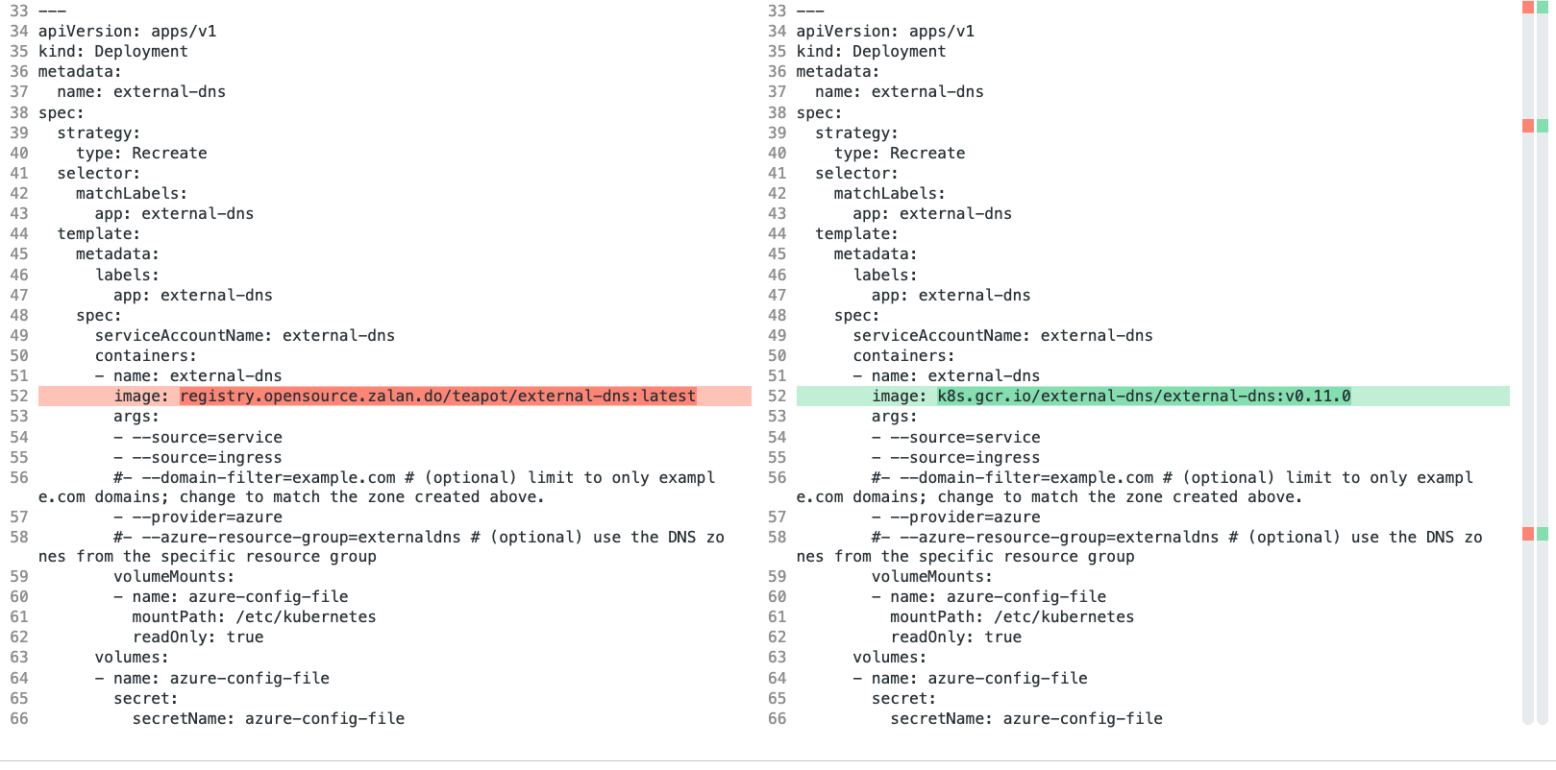
External DNS Updates
www.corvit.com

Slide 77
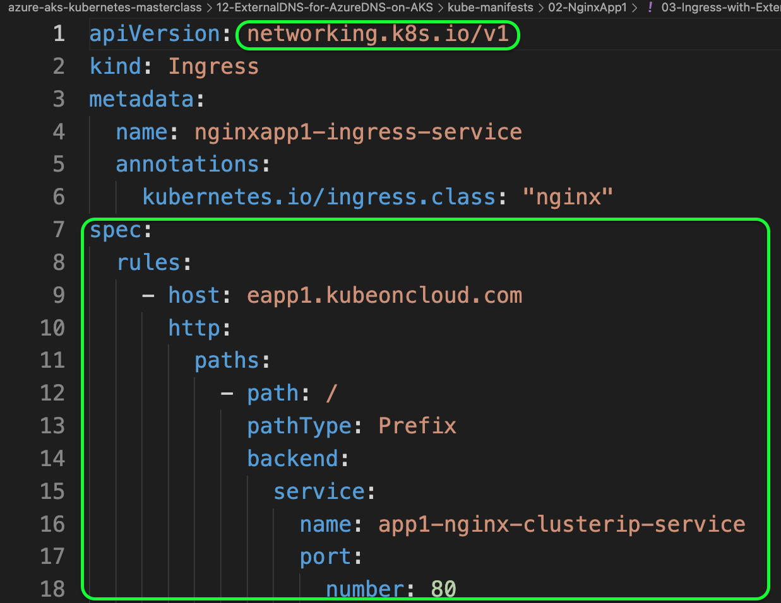
Ingress Service Updates
www.corvit.com

Slide 78
DNS
Zones
Managed
Service
Identity
Azure AKS
Nginx Ingress Service
Domain Name
based
Routing
www.corvit.com

Slide 79



Azure AKS Nginx Ingress External DNS Domain Name based Routing
Azure
Azure AKS Cluster
Virtual Machine
Scale Sets
DNS
Zones
Managed
Service
Identity
Nginx App1
External DNS
eapp1.kubeoncloud.com
eapp2.kubeoncloud.com
Users
eapp1.kubeoncloud.com
eapp3.kubeoncloud.com
Nginx App2
Ingress Service
eapp2.kubeoncloud.com
Public IP
for Ingress
Controller
Ingress Controller
AKS
Load Balancer
Usermgmt WebApp
eapp3.kubeoncloud.com
www.corvit.com

Slide 80
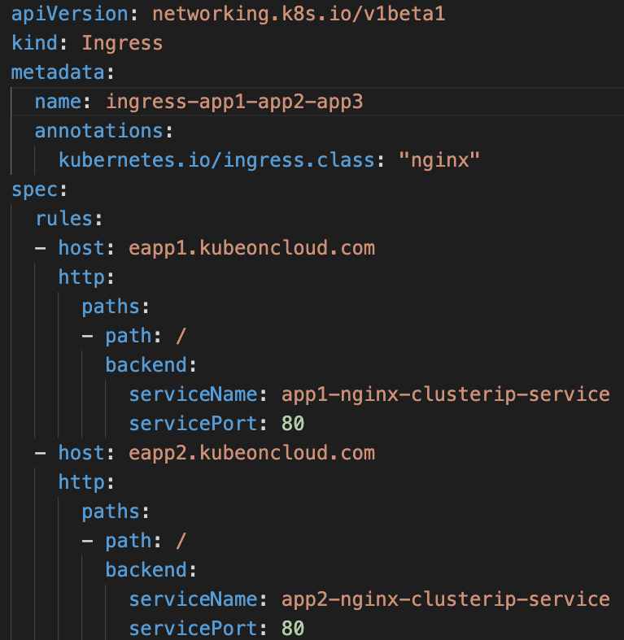
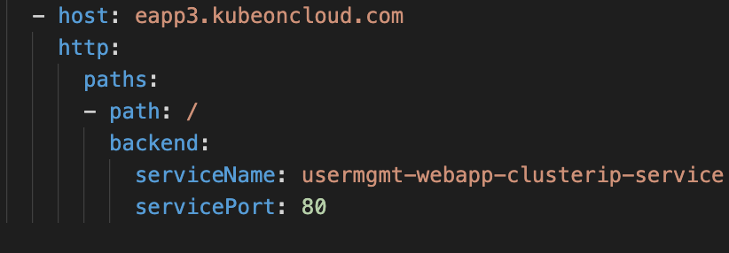
Ingress with External DNS and Domain Name based Routing
Ingress
Domain Name
Based
Routing
www.corvit.com

Slide 81
DNS
Zones
Managed
Service
Identity
Azure AKS
Nginx Ingress Service
Ingress SSL
Automatically generate and renew ssl certificates
www.corvit.com

Slide 82
Kubernetes Cert Manager
cert-manager is a native Kubernetes certificate management controller.
It can help with issuing certificates from a variety of sources, such as Let’s Encrypt, HashiCorp Vault, Venafi, a simple signing key pair, or self signed.
It will ensure certificates are valid and up to date, and attempt to renew certificates at a configured time before expiry.
Reference: https://cert-manager.io/docs/
www.corvit.com

Slide 83
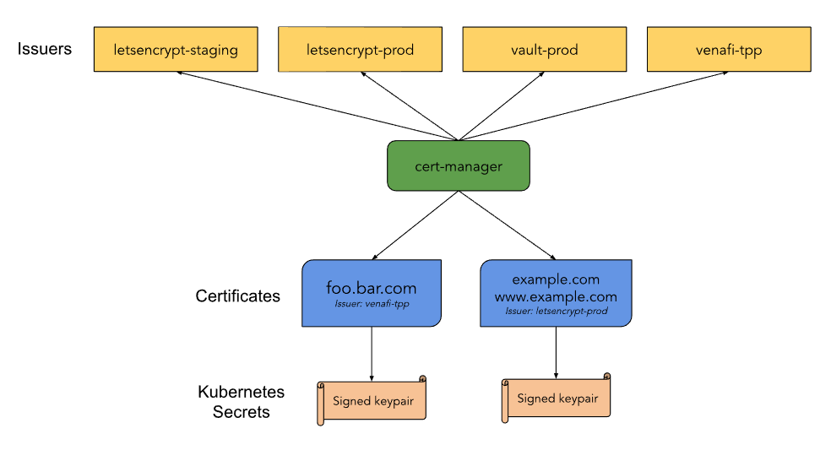
Kubernetes cert-manager
www.corvit.com

Slide 84
Azure AKS Nginx Ingress External DNS SSL with Lets Encrypt
Azure
Azure AKS Cluster
Virtual Machine
Scale Sets
External DNS
DNS
Zones
Managed
Service
Identity
5 mins to 1 hour
cert-manager
sapp1.kubeoncloud.com
sapp2.kubeoncloud.com
https://sapp1.kubeoncloud.com/app1/index.html
Nginx App1
https://sapp2.kubeoncloud.com/app2/index.html
Ingress Service
HTTPS
Users
Public IP
for Ingress
Controller
Ingress Controller
AKS
Load Balancer
Nginx App2
www.corvit.com

Slide 85
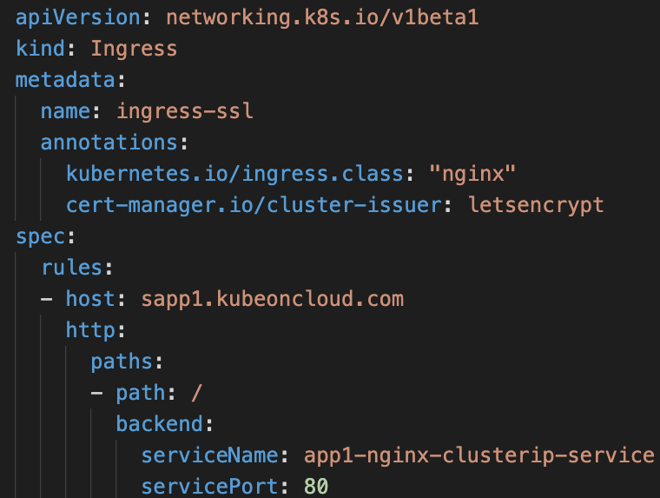
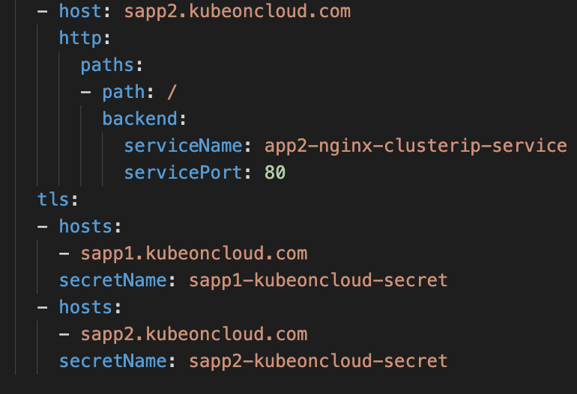
Ingress with External DNS, DNR and SSL
Ingress SSL Settings
www.corvit.com

Slide 86
Kubernetes
Resources
Requests & Limits
www.corvit.com

Slide 87
Kubernetes - Resources Requests & Limits
We can specify how much each container in a pod needs the resources like CPU & Memory.
When we provide this information in our pod definition for a specific container, the scheduler uses this information to decide which node to place the Pod on based on availability of k8s worker Node CPU and Memory Resources.
When you specify a resource limit for a Container, the kubelet enforces those `limits` so that the running container is not allowed to use more of that resource than the limit you set.
The kubelet also reserves at least the request amount of that system resource specifically for that container to use.
www.corvit.com

Slide 88
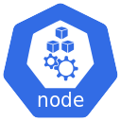
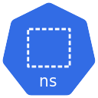
Kubernetes – Requests & Limits
K8s cluster
K8s Node
default namespace
CPU: 8 vcores
(8000m)
Container-1
Container-2
Memory: 32GB
CPU: 500m
CPU: 1000m
CPU: 500m
CPU: 1000m
Mem: 128Mi
Mem: 500Mi
Mem: 128Mi
Mem: 500Mi
Requests
Limits
Requests
Limits
www.corvit.com

Slide 89
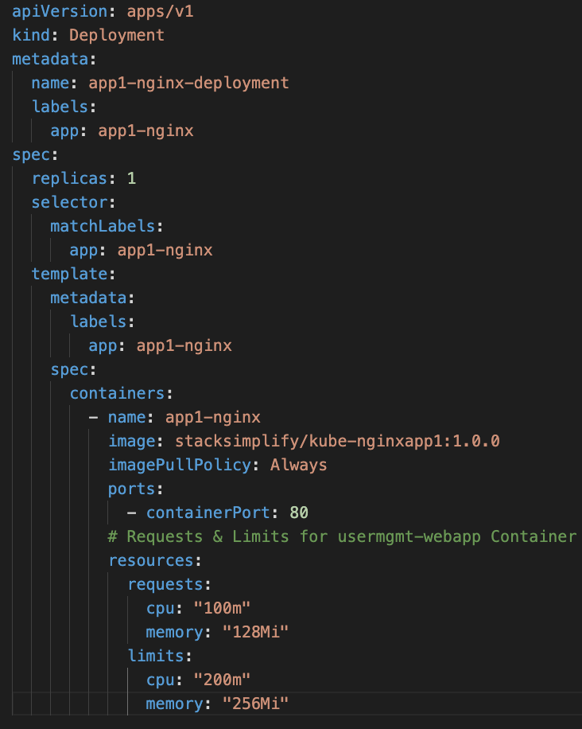
Kubernetes Requests & Limits
We have defined Requests & Limits for a specific container in a Deployment Manifest.
www.corvit.com

Slide 90
Kubernetes
Namespaces
www.corvit.com

Slide 91
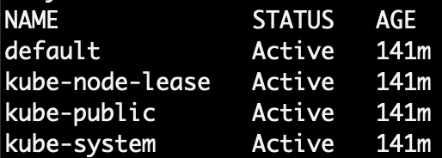
Kubernetes - Namespaces
Namespaces are also called Virtual clusters in our physical k8s cluster
We use this in environments where we have many users spread across multiple teams or projects
Clusters with tens of users ideally don’t need to use namespaces
Benefits
Creates isolation boundary from other k8s objects
We can limit the resources like CPU, Memory on per namespace basis (Resource Quota).
www.corvit.com

Slide 92
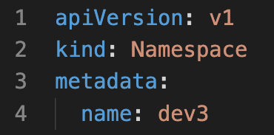
Kubernetes - Namespaces
LoadBalancer Service
LoadBalancer Service
LoadBalancer Service
F
F
F
Pod
Pod
Pod
Namespace Manifest - Declarative
ReplicaSet
ReplicaSet
ReplicaSet
Deployment
Deployment
Deployment
ClusterIP Service
ClusterIP Service
ClusterIP Service
B
B
B
Pod
Pod
Pod
ReplicaSet
ReplicaSet
ReplicaSet
Deployment
Deployment
Deployment
Namespace: dev
Namespace: qa
Namespace: staging
Namespace Manifest - Imperative
Deployment
www.corvit.com

Slide 93
Kubernetes - Namespaces
K8s cluster
K8s Node
default namespace
dev namespace
qa namespace
App1
App1
App1
App2
App2
App2
www.corvit.com

Slide 94
Kubernetes - Namespaces & DNS
K8s cluster
K8s Node
default namespace
dev namespace
qa namespace
App1
App1
App1
app1.default.svc.cluster.local
app1.dev.svc.cluster.local
app1.qa.svc.cluster.local
<service-name>.<namespace-name>.svc.cluster.local
www.corvit.com

Slide 95
Kubernetes
Namespaces
Limit Range
www.corvit.com

Slide 96
Namespaces – Limit Range
By default, containers run with unbounded compute resources on a Kubernetes cluster.
With resource quotas, cluster administrators can restrict resource consumption and creation on a namespace basis.
Within a namespace, a Pod or Container can consume as much CPU and memory as defined by the namespace's resource quota.
There is a concern that one Pod or Container could monopolize all available resources.
A LimitRange is a policy to constrain resource allocations (to Pods or Containers) in a namespace.
www.corvit.com

Slide 97
Namespaces – Limit Range
A LimitRange provides constraints that can:
Enforce minimum and maximum compute resources usage per Pod or Container in a namespace.
Enforce minimum and maximum storage request per PersistentVolumeClaim in a namespace.
Enforce a ratio between request and limit for a resource in a namespace.
Set default request/limit for compute resources in a namespace and automatically inject them to Containers at runtime.
www.corvit.com

Slide 98
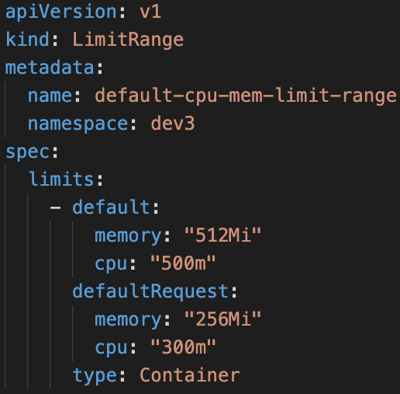
Limit Range
LoadBalancer Service
LoadBalancer Service
LoadBalancer Service
F
F
F
Pod
Pod
Pod
Limit Range Manifest
ReplicaSet
ReplicaSet
ReplicaSet
Deployment
Deployment
Deployment
ClusterIP Service
ClusterIP Service
ClusterIP Service
B
B
B
Pod
Pod
Pod
ReplicaSet
ReplicaSet
ReplicaSet
Deployment
Deployment
Deployment
Deployment
CPU
Memory
CPU
Memory
CPU
Memory
default
Min/Max
default
Min/Max
default
Min/Max
Limit Range (Per Container)
Limit Range (Per Container)
Limit Range (Per Container)
Namespace: dev
Namespace: qa
Namespace: staging
www.corvit.com

Slide 99
Kubernetes
Namespaces
Resource Quota
www.corvit.com

Slide 100
Namespaces - Resource Quota
When several users or teams share a cluster with a fixed number of nodes, there is a concern that one team could use more than its fair share of resources.
Resource quotas are a tool for administrators to address this concern.
A resource quota, defined by a ResourceQuota object, provides constraints that limit aggregate resource consumption per namespace.
It can limit the quantity of objects that can be created in a namespace by type, as well as the total amount of compute resources that may be consumed by resources in that project.
www.corvit.com

Slide 101
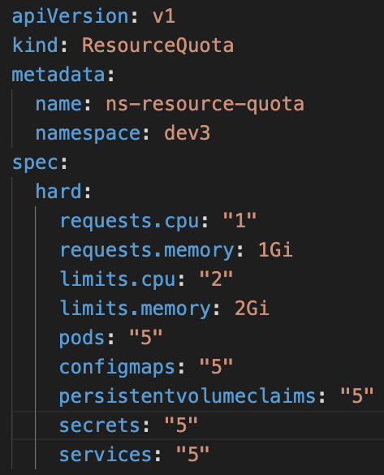
Resource Quota
LoadBalancer Service
LoadBalancer Service
LoadBalancer Service
F
F
F
Resource Quota Manifest
Pod
Pod
Pod
ReplicaSet
ReplicaSet
ReplicaSet
Deployment
Deployment
Deployment
ClusterIP Service
ClusterIP Service
ClusterIP Service
B
B
B
Pod
Pod
Pod
ReplicaSet
ReplicaSet
ReplicaSet
Deployment
Deployment
Deployment
Deployment
CPU
Memory
CPU
Memory
CPU
Memory
Pods
Services
Pods
Services
Pods
Services
Resource Quota
Resource Quota
Resource Quota
Namespace: dev
Namespace: qa
Namespace: staging
www.corvit.com

Slide 102

Azure AKS
Azure Container Registry (ACR)
www.corvit.com

Slide 103
Azure Container Registry - Introduction
Azure Container Registry is a managed, private Docker registry service
We can create and maintain Azure container registries to store and manage our private Docker container images.
With ACR, we can simplify our container lifecycle management.
Geo-replication to efficiently manage a single registry across multiple regions
Automated container building and patching including base image updates and task scheduling
Integrated security with Azure Active Directory (Azure AD) authentication, role-based access control, Docker Content Trust and virtual network integration
www.corvit.com

Slide 104
Azure AKS
Azure Container Registry (ACR)
Integrate ACR & AKS
www.corvit.com

Slide 105

Azure ACR and AKS - Integration
Docker Developer
Azure Cloud
Azure Container
Registry
Azure AKS Cluster
Build and Push
Docker Image
Integrate ACR and AKS
Azure AKS Cluster
Control Plane
Pull Docker Image from ACR
http://<public-ip>
Users
Public IP
App1 LB
Nginx App1
AKS
Load Balancer
www.corvit.com

Slide 106
Run
AKS Node Pools
Azure AKS
Azure Container Registry (ACR)
Pull Images from ACR using Service Principal
www.corvit.com

Slide 107
Pull Docker Images from ACR using Service Principal
Run on Azure AKS Nodepools
Docker Developer
Azure Cloud
Azure Container
Registry
Azure AKS Cluster
Build and Push
Docker Image
Azure AKS Cluster
Control Plane
Pull Docker Image from ACR
docker-server (ACR)
docker-username
http://<public-ip>
docker-password
Users
Public IP
App1 LB
Nginx App1
AKS
Load Balancer
AKS Node Pool
www.corvit.com

Slide 108
Schedule on
AKS Virtual Nodes
Azure AKS
Azure Container Registry (ACR)
Pull Images from ACR using Service Principal
www.corvit.com

Slide 109
Pull Docker Images from ACR using Service Principal
Run on Azure Virtual Nodes
Docker Developer
Azure Cloud
Azure Container
Registry
Azure AKS Cluster
Azure AKS Cluster
Control Plane
Build and Push
Docker Image
Pull Docker Image from ACR
docker-server (ACR)
docker-username
docker-password
http://<public-ip>
Nginx App1
Users
Public IP
App1 LB
Virtual Node - ACI
AKS
Load Balancer
www.corvit.com

Slide 110

Github
Azure
DevOps
Azure
Pipelines
Azure
Container Registry
Azure AKS
Azure DevOps
Build & Push
Docker Image to ACR
www.corvit.com

Slide 111
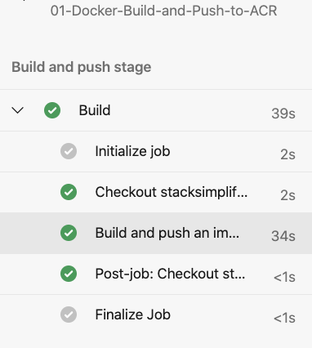

Azure DevOps Pipelines – Build & Push Docker Image to ACR
Azure Cloud
Azure DevOps
Github
Azure Pipelines
(Build & Push)
Azure Container Registry
Developer
www.corvit.com

Slide 112
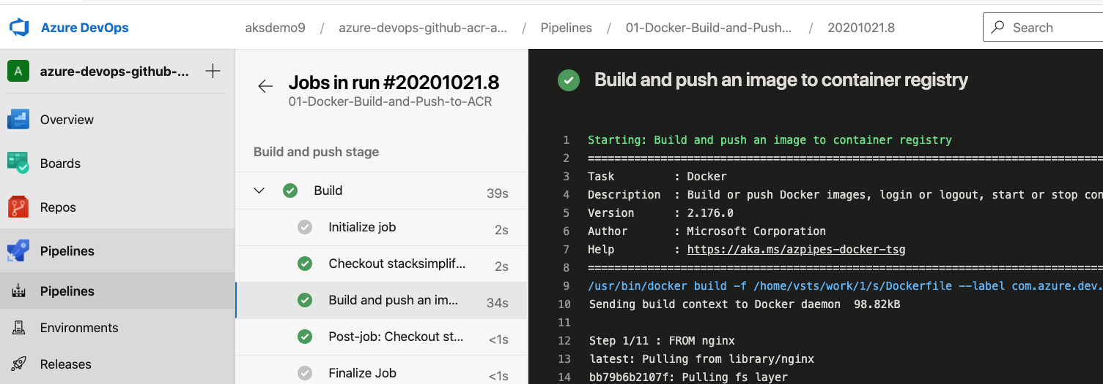
Azure DevOps Pipelines – Build & Push Docker Image to ACR
www.corvit.com

Slide 113
Github
Azure
DevOps
Azure
Pipelines
Azure
Container Registry
Azure AKS
Azure DevOps
Build & Push
Docker Image to ACR
Deploy to AKS
www.corvit.com

Slide 114
Azure DevOps – Build & Push Docker Image to ACR & Deploy to AKS
Azure DevOps
Azure Cloud
Developer
Azure Pipelines
1
2
Stage-1: Build & Push to ACR
4
Stage-2: Deploy to AKS
Github
5
Azure AKS Cluster
3
default namespace
Nginx App1
6
Azure Container Registry
www.corvit.com

Slide 115

Github
Azure
DevOps
Azure
Pipelines
Azure
Container Registry
Azure AKS
Azure DevOps
Build & Push
Docker Image to ACR, Publish Artifacts
STARTER PIPELINE
www.corvit.com

Slide 116
Azure Pipelines – Key Concepts
Pipeline
Stages
Steps
Trigger
Stage-1: Build
Agent
Step-1: script: echo Hello, world!
Job
Stage-2: AA
Step-2: Task-1: Docker Build & Push to ACR
Github
Agent
Stage-3: BB
Job
Step-3: Task-2: Copy Files to Build Artifact Directory
Stage-4: CC
Job
Step-4: Task-3: Publish Artifacts to Azure Pipelines
Developer
www.corvit.com

Slide 117
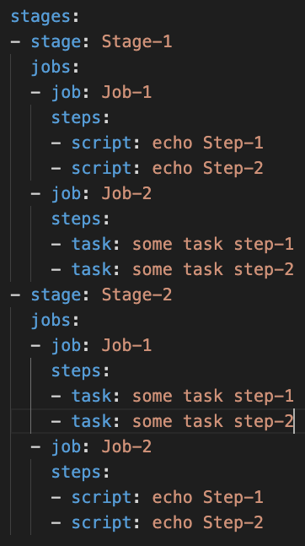
Azure Pipelines – Key Concepts
Stages
Stage-1
Jobs
Job-1
Steps
Step-1: Script
Step-2: Task
Job-2
Steps
Step-1: Task
Step-2: Task
Stage-2
Jobs
Job-1
Steps
Step-1: Script
Step-2: Script
Job-2
Steps
Step-1: Task
Step-2: Task
www.corvit.com

Slide 118
Azure Pipelines – Starter Pipeline
Goal
Create a Pipeline that will build docker images, push them to Azure Container Registry and Publish Kubernetes Manifests to Azure Pipelines
Part-1
Semi Customized
Part-2
Fully Customized using Starter Pipeline
Task-1
Use pre-defined Docker Build & Push Pipeline
Task-1
Start using Starter pipeline and use Docker Build or Push Docker Images Task
Task-2
Customize Pipeline to Use Copy Files Task
Task-2
Customize Pipeline to Use Copy Files Task
Task-3
Customize Pipeline to Use Publish Build Artifacts Task
Task-3
Customize Pipeline to Use Publish Build Artifacts Task
www.corvit.com

Slide 119
Azure DevOps – Build Pipeline
Task-1
Docker Image Build and Push to Azure Container Registry
Task-2
Copy files (kube-manifests folder) from System default working Directory to Build Artifact Directory
Task-3
Publish Build Artifacts to Azure Pipelines, so that we can use them in Release Pipelines
www.corvit.com

Slide 120
Azure
DevOps
Azure
Pipelines
Azure
Container Registry
Azure
Release Pipelines
Github
Azure AKS
Azure DevOps
Release Pipelines
Continuous Delivery
www.corvit.com

Slide 121
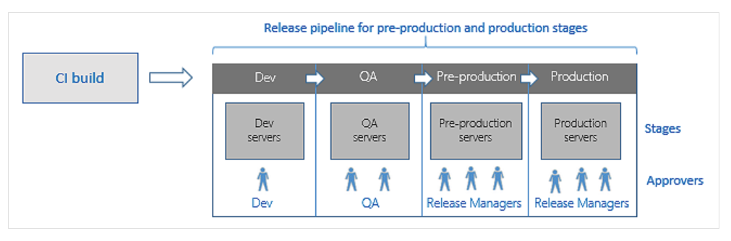
Azure DevOps – Release Pipelines
To achieve Continuous Delivery we use Release Pipelines
www.corvit.com

Slide 122
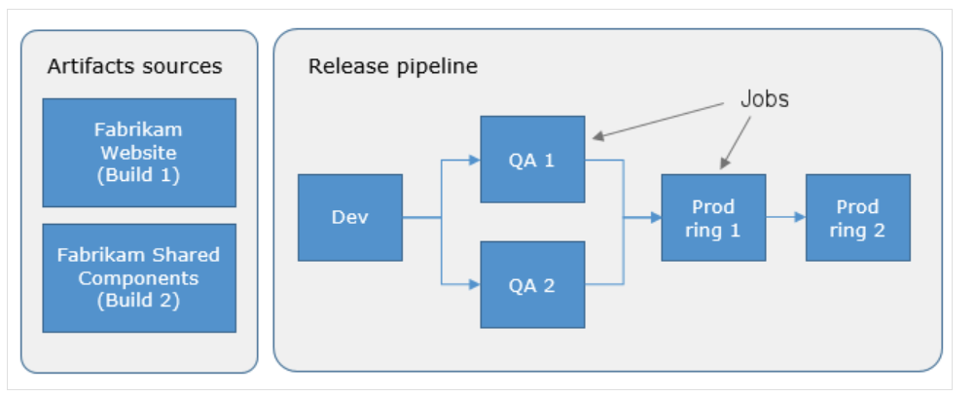
Azure DevOps – Release Pipelines
www.corvit.com

Slide 123


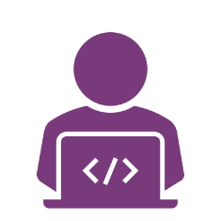
Developer
Github
Azure DevOps – Release Pipelines
1
2
Azure Cloud
Azure DevOps
Release Pipelines
QA
Azure Pipelines
7
Stage-1: Build & Push to ACR
4
Dev
Staging
12
Prod
3
10
Azure Container Registry
6
5
9
8
Azure AKS Cluster
12
11
14
13
dev namespace
qa namespace
Staging namespace
prod namespace
Nginx App1
Nginx App1
Nginx App1
Nginx App1
www.corvit.com

Slide 124
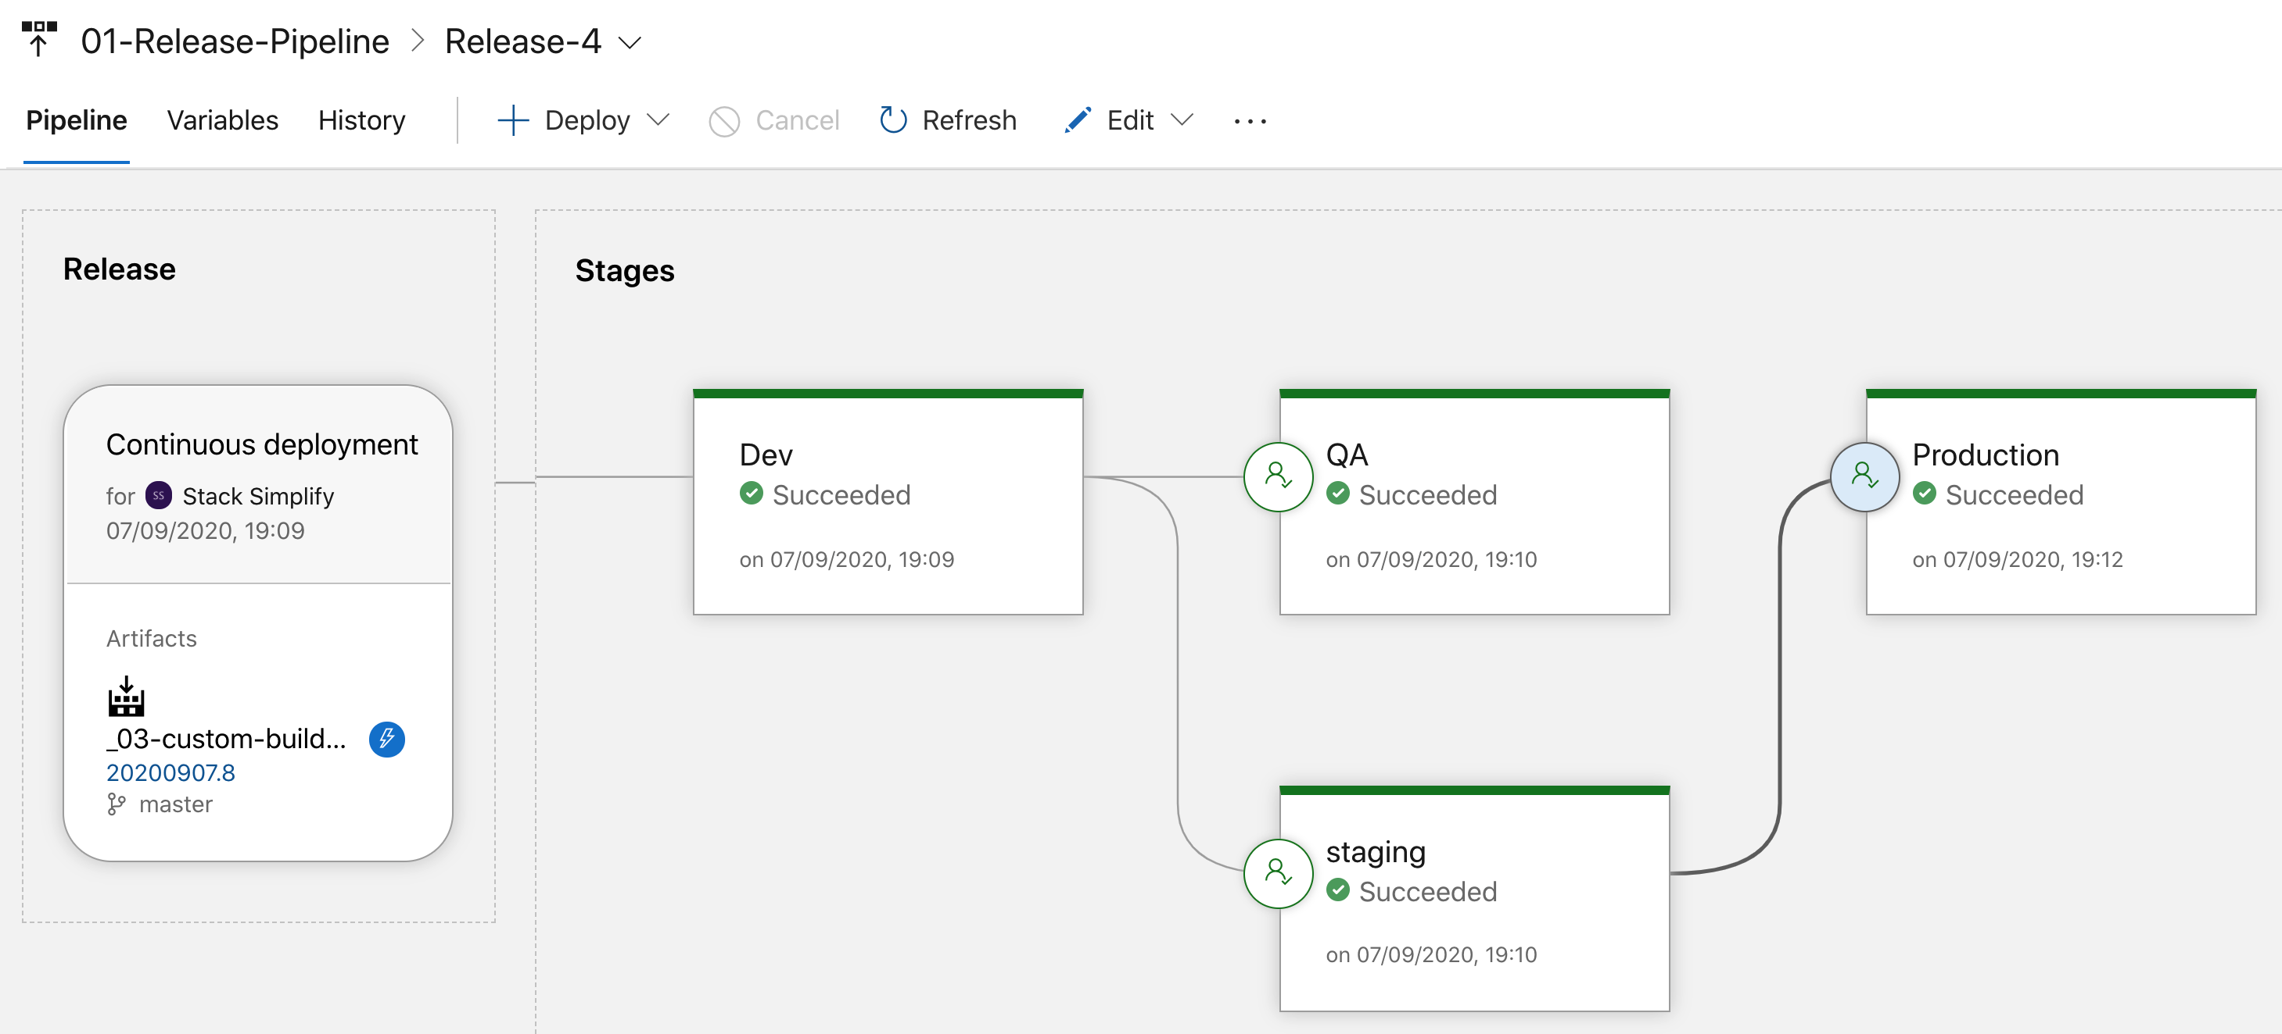
Azure Release Pipelines
www.corvit.com

Slide 125
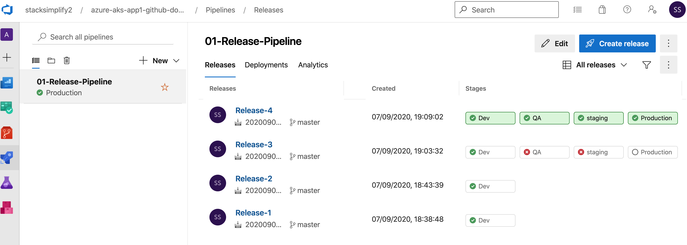
Azure Release Pipelines - Releases
www.corvit.com

Slide 126
AKS Addon
DNS
Zones
Managed
Service
Identity
Azure AKS
HTTP Application Routing Add On
Ingress Controller + External DNS
www.corvit.com

Slide 127
Azure AKS HTTP Application Routing Add On Ingress + External DNS (Automatic Install)
Azure Cloud
Azure AKS Cluster
app1.7b8803340f38495c8402.centralus.aksapp.io
7b8803340f38495c8402.centralus.aksapp.io
DNS Zones
Nginx App1
External DNS
app1.7b8803340f38495c8402.centralus.aksapp.io
app1.7b8803340f38495c8402.centralus.aksapp.io
Users
Public IP
for Ingress
Controller
Ingress Controller
Ingress Service
AKS
Load Balancer
HTTP Application Routing Add On
www.corvit.com

Slide 128
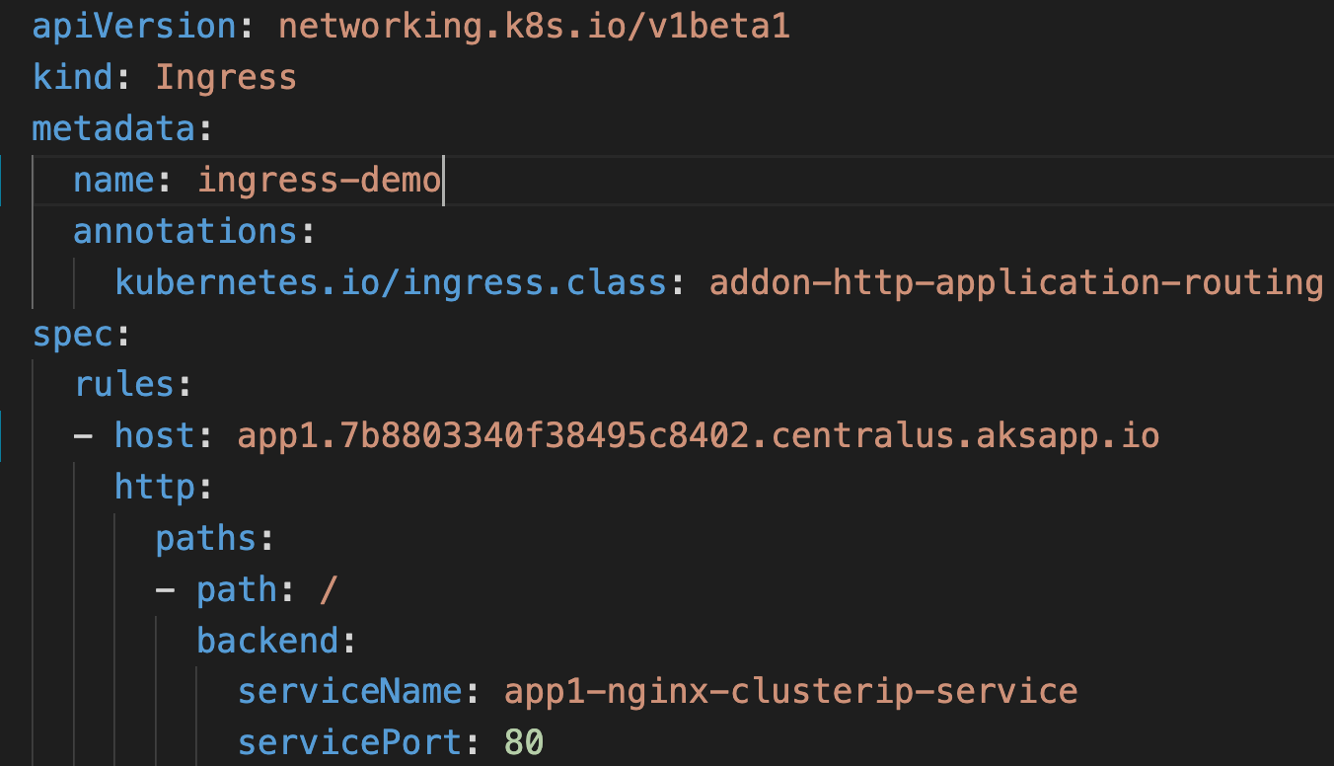
Ingress with External DNS
This annotation will ensure the ingress service we are creating will be part Ingress Controller created using HTTP Application Routing Add On
This will help us to add DNS Record Set in Azure DNS Zones using k8s External DNS
www.corvit.com

Slide 129
Which Ingress Controller to Use?
Nginx Ingress Controller (Open Source)
Azure Application Gateway Ingress Controller (AGIC)
Free of cost, only uses AKS memory and cpu resources
Very costly and still uses AKS memory and cpu resources
Stable and very very good open source community support.
Recently launched and most of the features are in preview mode.
Good for smaller workloads and smaller deployment foot print
Good for large scale workloads, at the same time who can afford the price
www.corvit.com

Slide 130
Cluster Autoscaler
Horizontal
Pod
Autoscaler
Azure AKS
Autoscaling
Nodes & Pods
www.corvit.com

Slide 131
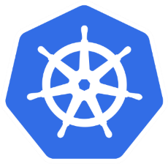
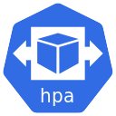
Azure AKS – Autoscaling Nodes & Pods
Azure Kubernetes Service (AKS) Cluster
Automatically auto-scale nodes
Cluster Autoscaler
Scale out
Automatically auto-scale pods
Horizontal Pod Autoscaler
Scale out
www.corvit.com

Slide 132
Azure AKS
Autoscaling
Cluster Autoscaler
www.corvit.com

Slide 133
Cluster Autoscaler - Introduction
Cluster Autoscaler is a tool that automatically adjusts the size of a Kubernetes cluster when one of the following conditions is true:
There are pods that failed to run in the cluster due to insufficient resources.
There are nodes in the cluster that have been underutilized for an extended period of time and their pods can be placed on other existing nodes.
The Cluster Autoscaler modifies our nodepools so that they scale out when we need more resources and scale in when we have underutilized resources.
www.corvit.com

Slide 134
Azure AKS
Autoscaling
Horizontal Pod Autoscaling
www.corvit.com

Slide 135
Horizontal Pod Autoscaler – HPA - Intoduction
In a very simple note Horizontal Scaling means increasing and decreasing the number of Replicas (Pods)
HPA automatically scales the number of pods in a deployment, replication controller, or replica set, stateful set based on that resource's CPU utilization.
This can help our applications scale out to meet increased demand or scale in when resources are not needed, thus freeing up your worker nodes for other applications.
When we set a target CPU utilization percentage, the HPA scales our application in or out to try to meet that target.
HPA needs Kubernetes metrics server to verify CPU metrics of a pod.
We do not need to deploy or install the HPA on our cluster to begin scaling our applications, its out of the box available as a default Kubernetes API resource.

Slide 136
How HPA works?
Metrics Server
Pod - 1
Pod - 2
Pod - N
2. Calculate the Replica’s
.
.
.
This control loop is executed every 15 seconds
15 secs
Horizontal Pod Autoscaler
1. Query for Metrics
Deployment
ReplicaSet
3. Scale the app to desired replicas
Scale
Replication Controller
StatefulSet
Application
Kubernetes Cluster
www.corvit.com

Slide 137
How is HPA configured?
Scaling Metric: CPU Utilization
Target Value - CPU = 50%
HPA requires
Min Replicas = 2
Max Replicas = 10
kubectl autoscale deployment demo-deployment --cpu-percent=50 --min=1 --max=10
www.corvit.com

